Slide 1




JEDDT
Congolese Venture Capital for Innovative Businesses.
Venture Capital Porto Folio
Note: Jeddt is not a real venture capital company

Slide 2

Table of Contents
Project Overview
Market Analysis
Pitch Deck Analysis
Due Diligence Recommendations
Term Sheet Analysis

Slide 3


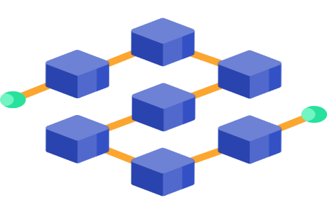
Project Overview
Focus
Jeddt aims to invest in revolutionary blockchain supply chain technologies with the capacity to revolutionise traditional industries, improve productivity, and fundamentally reshape business operations. Our focus is on supporting early-stage start-ups with experience in supply chain and blockchain across diverse sectors.
Trend
Improving supply chain management by using blockchain to increase security and traceability.
Areas of interest
Supply chain transparency, Product authentication, contract execution efficiency, quality control and inventory management
Supply chain
BlockChain

Slide 4



Market Analysis
The market size of the global blockchain supply chain was valued at USD 260.69 million in 2021 and is projected to grow at a CAGR of 54.34% through the forecast period, reaching USD 3523.14 million by 2027. The forecast period from 2023 to 2030 is expected to witness a significant increase in the Global Blockchain Supply Chain market. In 2022, the market is demonstrating steady growth, and with key players implementing various strategies, it is anticipated to continue its upward trajectory.
Customer Perception
Customer perceptions of blockchain in the supply chain vary, with concerns about scalability during implementation. Companies considering blockchain adoption may face challenges, especially with complex processes and legacy systems. Despite these hurdles, many customers view blockchain positively for its potential to enhance transparency, traceability, and overall efficiency. Blockchain's ability to provide detailed information about product origin, production, and journey aligns with consumer preferences for authenticity and ethical sourcing. Notably, a 2019 survey found that 63% of Americans would pay up to a third more for responsibly made and transparently sourced products, while 94% would be more loyal to brands offering complete transparency.
Customer Analysis
Customers in blockchain supply chain are businesses, governments, and organisations that seek to improve their efficiency in tracking, secure and improve the traceability of their products in the supply chain management.

Slide 5


Market Outlook
The Blockchain Supply Chain Market size is expected to grow from USD 0.56 billion in 2023 to USD 4.21 billion by 2028, at a CAGR of 49.87% during the forecast period (2023-2028) (Blockchain Supply Chain Market Insights, 2023). With the growing acknowledgment of the advantages offered by blockchain technology, we can expect to see greater adoption across the entire supply chain. This trend is poised to establish a more interconnected and efficient ecosystem, yielding benefits for all parties involved in the supply chain process.
2023
2028

Slide 6



Recent Trends
Pharmaceutical Industries: A key factor propelling growth is the integration of blockchain in the pharmaceutical sector to address the issue of counterfeit drugs. Through authenticating the legitimacy of medications at every stage, the technology plays a crucial role in stopping the entry of fraudulent pharmaceuticals. This not only safeguards patient well-being but also contributes to the expansion of the market.
Counterfeit sneakers: Approximately 40% of the estimated USD 600 billion global counterfeit fashion industry is attributed to fake sneakers. Conventional methods employed by manufacturers to ensure authenticity, such as seals and certificates, are susceptible to counterfeiting themselves. However, retailers are now starting to integrate blockchain technology as a solution to address the issue of counterfeiting in the industry.
In the automotive sector, blockchain is utilized in supply chains to create a reliable record of a vehicle's history, including parts replacements, repairs, and accidents. This transparency benefits both buyers and sellers in the used vehicle market, positively impacting market growth. The rising demand for refurbished vehicles further drives the advancement of the blockchain supply chain market within the automotive industry.

Slide 7


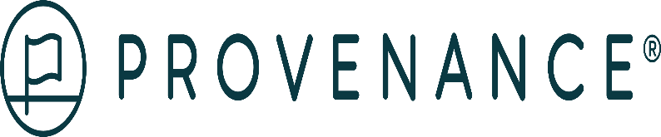
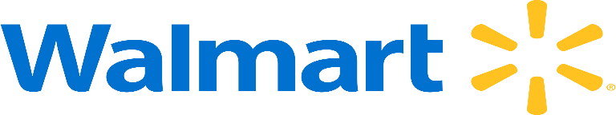
Key Players
Overview
Provenance is a technology company using blockchain to enhance transparency in supply chains, particularly in food and fashion. The platform creates an immutable ledger for products, emphasizing supply chain transparency and ethical practices.
Deals
Provenance raised $5 million in Series A round. The round included 10 investors, including Angel Academe, Working Capital, Digital Currency Group, Nordic Eye, Brandtech Group, WakeUp Capital, and The Index Project.
GANNI partnered with Provenance, a transparency technology solution provider. The partnership allows GANNI to be transparent about the environmental impact of their clothing and the people who make them.
Overview
Amazon is a multinational technology company based in Seattle, Washington. Founded by Jeff Bezos in 1994 that focuses on e-commerce, cloud computing, digital streaming, and artificial intelligence. It is considered one of the Big Five American technology companies.
Deals
Amazon committed an investment of close to USD 500 million to combat abuse and fraud, particularly counterfeit activities. These efforts successfully thwarted almost 2.5 million suspected fake accounts, preventing any of their products from being made available for sale.
Overview
Walmart is a multinational retail company that operates in both the retail and wholesale sectors. As of January 2023, Walmart is the world's largest retailer, with 10,623 stores and 380 distribution facilities in 27 countries. In February 2023, Walmart announced that its FY2023 total revenue was $611.3 billion.
Deals
Walmart Canada announced a $3.5 billion investment in blockchain, AI, and IoT over the next five years. The investment is part of a digital transformation plan that includes developing smarter stores and distribution centers, and partnering with local tech companies.
Walmart began using IBM's Food Trust network to trace over 25 product types.

Slide 8


Startup Evaluation
Based on my research on the use of blockchain in the supply chain sector, I picked up 3 promising startups companies which are:
Blockhead Technologies
Te-Food
Konexial

Slide 9



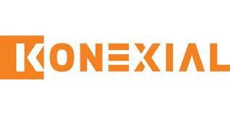
Startup Evaluation
Insight
Blockhead Technologies offers a good track record revenues and demonstrated expertise in delivering blockchain solutions in a market where the implementation of blockchain within enterprises’ supply chain can be difficult due to the fact blockchain is still an emerging technology.
Questions
What is the metric of the recent customer traction ?
What is the satisfaction of customer that interacted with Blockhead Technologies?
Will blockhead Technologies be able to conserve its competitive advantage in the next 10 years?
Insights
Te-Food's blockchain-based food traceability approach, emphasizing quality, gives it a unique market advantage and significant long-term growth potential. This strategic focus addresses critical issues in the food supply chain, reducing health risks during outbreaks in emerging countries.
Questions?
Does the company intend to extend their partnerships with farmers or supplier in Africa ?
How the company can reach the potential customers market in Africa?
Insights
Konexial’s ability to integrate Dynamic Load Matching (DLM) and blockchain technology to optimise resource allocation backed up with founders who have a strong experience in blockchain and supply chain gives a good competitive advantage to company within the transportation sector.
Questions
What is the strategy of the company to reach new customers ?
How the company’s solution can be applied in Africa ?
Is company able to provide their services to small freight companies ?

Slide 10

Startup Recommendation
Te-Food stands out the best based on its revenue where it increased its revenue from $4M to $12M in a year. The company’s customer traction is quite good with more than 6000 business customers and serving 150 million people with fresh food, and the fact Te-Food focuses on food traceability, including quality as well, it reduces the impact of foodborne illness outbreak in emerging countries. Finally, the flexibility of financial model of Te-food, implemented in a public private partnership model which requires minimal investment, makes company very attractive to investors.

Slide 11

Case Study: Graphite Docs Failure
Graphite Docs was an open-source collaborative online office suite designed to facilitate document creation, editing, and collaboration in real-time. Graphite Docs, a privacy-focused alternative to Google Docs powered by blockchain, that assured users that their saved files were indeed safe.
The company started gaining traction from individual users. However, Graphite Docs focused on the B2B model, rather than B2C, and this business model led the company to failure in 2020.

Slide 12

Case Study: Graphite Docs Failure
Why did the startup fail?
Graphite Docs failed primarily due to a lack of execution and a failure to adapt based on user feedback. The founder initially gained traction but misunderstood early success as achieving product/market fit. The focus on a niche market, namely blockchain enthusiasts and privacy-focused users, led to a misguided pivot towards a business-to-business (B2B) model. The founder's comfort with B2B operations overshadowed the existing user base, causing a mismatch between the product's complexity and the targeted audience. Grant money and external funding created a false sense of success, further delaying the realization that the chosen market was not adopting the product. The founder's reluctance to make tough decisions and the misalignment of business models ultimately led to Graphite Docs' closure.

Slide 13

Case Study: Graphite Docs Failure
Due Diligence Research
To avoid the fate of Graphite Docs, startups should prioritise continuous user feedback, conduct thorough market research, ensure genuine product-market fit, align the business model with the target market, focus on financial sustainability, maintain founder awareness and adaptability, proactively mitigate risks, understand the user base, engage in strategic planning, address legal considerations, and foster a strong team dynamic. Diligence in these areas increases the likelihood of startup success and minimizes the risk of failure.

Slide 14
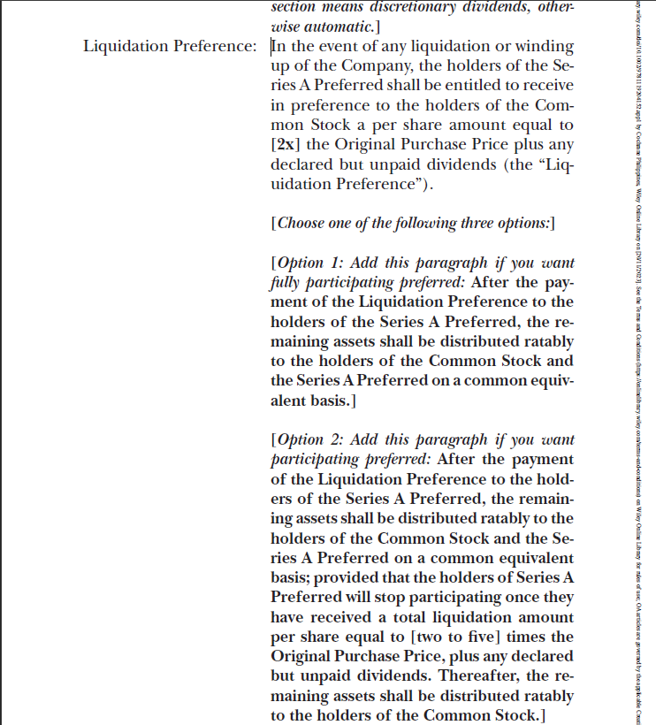
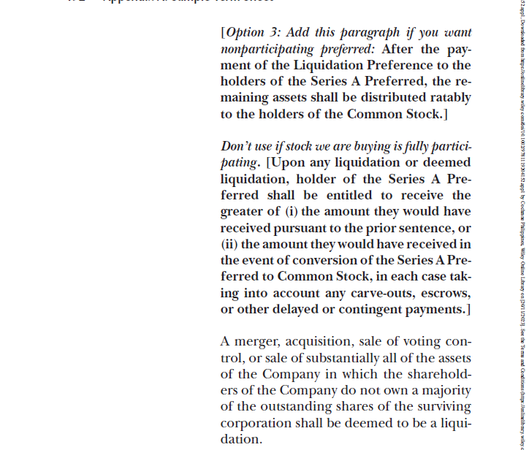
Term Sheet Analysis
Liquidity preferences
The section is known as "Liquidation Preference," and its purpose is to determine the order of how money comes out of the company in the event of the company's liquidation or acquisition.
Rights or Obligations in this context involves that Series A Preferred stockholders receive a per-share amount, 2x times from the original purchase price and any declared dividends before Common Stock holders.
Options for Distribution:
Option 1 (Fully Participating): After the payment of the liquidation event, the investors take their money back and the remaining assets must be shared ratably between Series A Preferred and Common Stock holders.
Option 2 (Participating): Similar to Option 1 but with a cap on Series A Preferred participation.
Option 3 (Nonparticipating): Remaining assets go to Common Stock holders after paying Liquidation Preference.
3. Influence on Relationship: These sections define the financial terms during liquidation, impacting trust and collaboration between investors and founders based on the chosen distribution option.

Slide 15
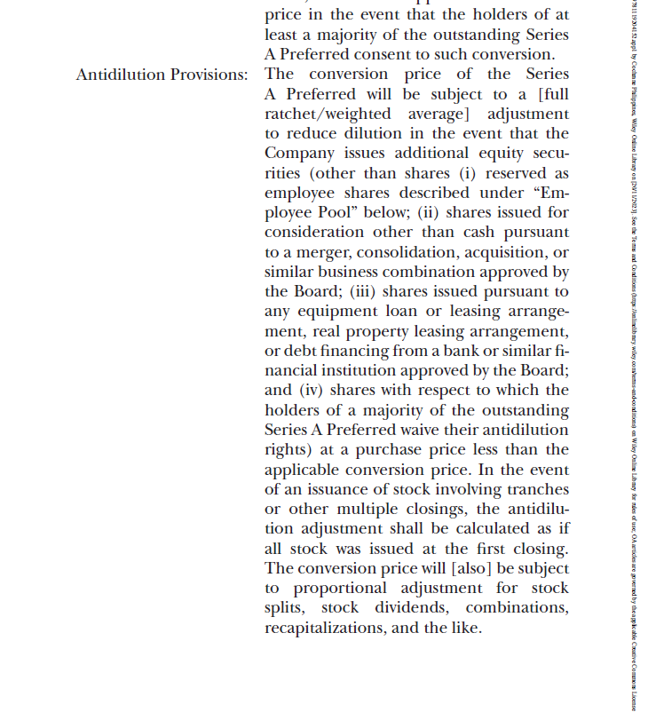
Term Sheet Analysis
Antidilution Provisions
Antidilution Provisions : It outlines the conditions and methods for adjusting the conversion price of existing investors’ share to prevent dilution when the company issues new equity at a lower price. For example If the company decides to sell new shares at a lower price, the investors who already invested at a higher price get some protection. The conversion price of their shares is adjusted to make sure they're not losing out if the company issues cheaper shares to others. It's like making sure everyone gets a fair deal.
Rights or Obligations Outlined for the Parties: Investors with Series A Preferred shares have the right to an adjustment in the conversion price if the company issues new equity securities at a lower price, protecting them from dilution.
Influence on Relationship: This antidilution provision protects the Series A Preferred investors from dilution by adjusting the conversion price when new shares are issued at a lower price. It ensures fairness in the value of their investment.

Slide 16
Term Sheet Analysis
Drag-Along Agreement
Drag-Along Agreement: It gives the investors the ability to require start a sale forcing other shareholders to join in the sale of the company to facilitate the liquidity event.
Rights or Obligations Outlined for the Parties: Rights: In the context of the term sheet provided, The holders of series A preferred have the right to initiate and lead a sale or liquidation of the company. Obligations: Other holders of Series A preferred and common stock are obligated to consent to and not object to the if a majority of Series A preferred holders choose to do so.
Influence on Relationship: This section ensures a streamlines process for a potential sale or liquidation. If a majority of series A preferred holders want to sell, others are obligated to go along with it. It helps in avoiding conflicts and ensures a unified decision.

Slide 17


